Slide 1
X-rays

Slide 2

By the end of this lesson you will be able to:
Define what x-rays are.
Describe the uses of x-rays.
Explain how people protect themselves from the harmful effects of x-rays.

Slide 3
X-rays are a type of electromagnetic wave.
X-rays have a very short wavelength, even shorter than visible and ultraviolet light.
They have an incredibly high penetrating power. This means we can use them to see the internal structure of objects.

Slide 4
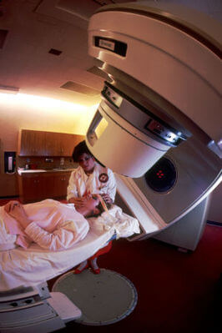
X-rays are very high energy waves.
This is because they have such a short wavelength.
They are able to damage cells and tissues. They can even damage the genetic material inside cells.
We can destroy cancer cells by targeting them with x-rays. This either kills them or stops them from multiplying.

Slide 5
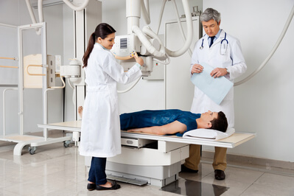
We can use x-rays to make a picture of somebody's bones or teeth.
This is used in radiology.
This works because materials which are different densities absorb different amounts of radiation.
Teeth and bones absorb much more radiation than muscle and fat.
The same principal applies to x-rays used at the airport to examine luggage.

Slide 6
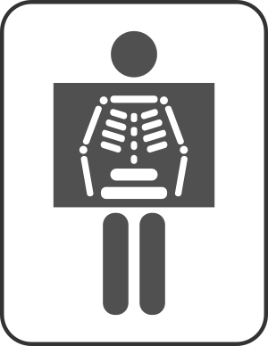
The denser structures of our bodies absorb the x-rays while the rest passes through our body.
If we combine this with a special plate or film that can also absorb x-rays the "shadow" caused by the x-rays that don't pass through our bones or teeth forms the image used for the x-ray.

Slide 7
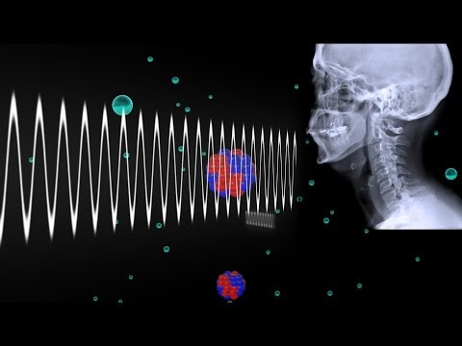

Slide 8
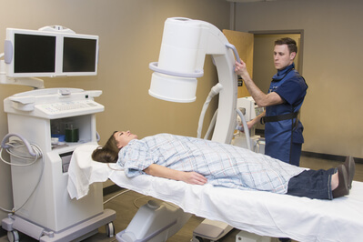
Radiographers and other people who work with x-rays need to protect themselves from its damaging effects.
They often use lead to do this, as x-rays cannot penetrate through lead.
Lead gloves, shields and aprons are all used to minimise exposure to x-rays.

Slide 9
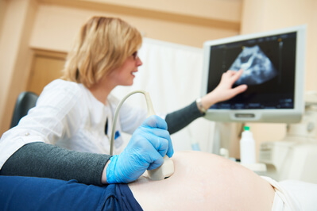
If we can see inside our bodies with X-rays, can we use them to see unborn babies?
Pregnant women do not use x-rays to directly view the baby.
This is because the developing foetus could be deformed by multiple x-rays.
Instead, the baby is monitored by ultrasounds, which are not harmful to babies.

Slide 10

However, pregnant women can still have an x-ray to see if they have a broken bone or tooth.
It is better to ensure the safety and health for the mother and by extension the baby, than let a possibly harmful injury go unnoticed.
The amount of radiation that could affect a developing foetus from a diagnostic x-ray is still far lower than the amount required to cause developmental harm.
If a pregnant mother is undergoing an x-ray while pregnant it is still best for them to let the doctor and the radiographer know that she is pregnant so they can advise her on the procedure and possible options.

